Slide 1
WATER BENEATH EARTH’S SURFACE

Slide 2
THE WATER CYCLE

Slide 3
VOCAB REVIEW
EVAPORATION
CONDENSATION
PRECIPITATION
TRANSPIRATION

Slide 4
PRECIPITATION: A CLOSER LOOK
75% GOES INTO OCEANS
25% hits land to become:
Runoff --Groundwater
A CLOSER LOOK AT PRECIPITATION

Slide 5
WHAT IS “GROUNDWATER”?
WATER THAT SEEPS (INFILTRATES) INTO OPENINGS (PORES) IN ROCKS & SEDIMENT
AFFECTED BY:
a. POROSITY - %OF OPEN SPACE
b. PERMEABILITY – HOW FREELY THE WATER PASSES THROUGH

Slide 6
WHAT IS “GROUNDWATER”?
GROUNDWATER moves through a permeable layer until it reaches an impermeable layer
AQUIFER – tap into for LARGE water supply (cities, towns)

Slide 7
“BUDGETING” OUR WATER
Like a financial budget, water is “budgeted” by geologists
Some terms:
1. income = precipitation
2. expense = evaporation, transpiration, run-off

Slide 8
“BUDGETING” OUR WATER
THE GLOBAL BUDGET IS ALWAYS BALANCED
OUR “LOCAL” BUDGET IS USUALLY NOT BALANCED
AFFECTED BY: Temperature, vegetation, wind,
how long it rains

Slide 9
Let’s practice doing a water budget

Slide 10
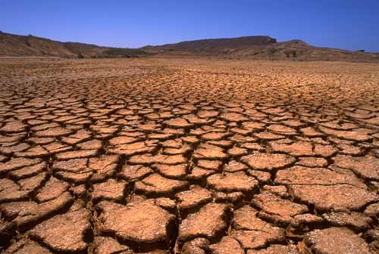
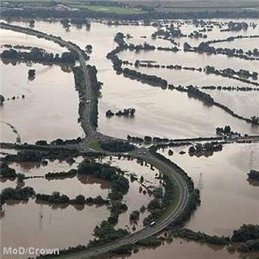
“BUDGETING” OUR WATER
Too much precip.: flooding
Too little precip.: drought

Slide 11
Once in the ground what’s it look like?
Groundwater zones
1. Zone of Saturation: lower portion – ALL pore spaces are filled
Top of this line is called the WATER TABLE!

Slide 12
Zone of Aeration: upper portion –
between water table & surface

Slide 13
THE WATER TABLE
The height of the water table is affected by:
1. Topography: hilly areas – deeper; swamps – closer to the surface
Climate: drier – deeper = deficit
wetter – surface water = surplus
3. Usage: overuse = deeper = deficit
Rain, snow, sleet = RECHARGES the water
table

